Slide 1
Intro to Optimization
Alice Paul
Brown University
Notes:
This course will cover mathematical tools to solve feasibility and optimization problems

Slide 2
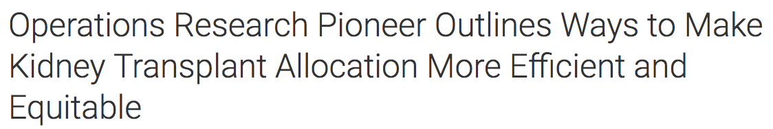

Operations Research
Operations Research is the application of scientific and mathematical methods to the study and analysis of problems involving complex systems. (INFORMS)
Notes:
Math programming is an important field in Operations Research
A lot of people ask what is operations research? Defn from society
Some recent applications of OR in the news which use math programming

Slide 3




Optimization
Objective Function
Set of Feasible Solutions
$$a$$
$$b$$
$$c$$
$$d$$
Question: Which solution should we return?
Notes:
Example: bus routes

Slide 4
Optimization Formulation
Math programming formulation:
Objective Function
Constraints
Variables
Question: What if we had a minimization problem?
Notes:
Want to encode this problem in a mathematical format
X represents range and format of variables (>= 0, integer)

Slide 5
A Simple Example
Question: Can you find the optimal solution?
Notes:
Say x = x1 and x2

Slide 6
Workflow
Problem
What we need to know
Gather Data
Problem Representation
Formulate Model
Algorithm/Recipe to Solve
Interpretation
Solve & Analyze
Notes:
Actually have up arrows after every stage

Slide 7
An Urgent Dilemma
Notes:
Ready to veg out when you run out of your favorite cookies! Luckily you have baking ingredients on hand – want to recreate the cookies

Slide 8
Group Exercise
Exercise: In groups of 2-3 discuss how you would describe the problem in English. You don’t need a mathematical model but try to be as specific as possible. Think about all the information you have available.
Our goal is to find the recipe for these cookies.
Notes:
Only thing we have is the label and internet

Slide 9
Group Exercise
Exercise: In groups of 2-3 discuss how you would describe the problem in English. You don’t need a mathematical model but try to be as specific as possible. Think about all the information you have available.
Our goal is to find the recipe for these cookies such that
I use the ingredients listed
the nutritional information matches the label
the proportion of ingredients match the label
A model is an abstraction of the actual problem.

Slide 10
What are the Variables?
The variables of a problem represent a possible solution. These are the unknowns or what we have control over.
Exercise: Write down the variables.

Slide 11
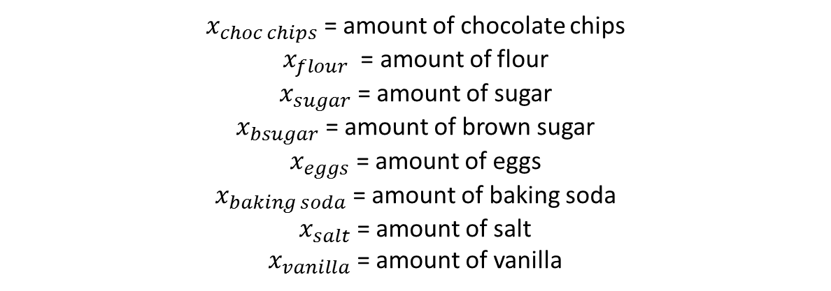
What are the Variables?
The variables of a problem represent a possible solution. These are the unknowns or what we have control over.
Exercise: Write down the variables.
$x_{choc chips}$ = amount of chocolate chips
$x_{flour}$ = amount of flour
$x_{sugar}$ = amount of sugar
$x_{bsugar}$ = amount of brown sugar
$x_{eggs}$ = amount of eggs
$x_{baking soda}$ = amount of baking soda
$x_{salt}$ = amount of salt
$x_{vanilla}$ = amount of vanilla

Slide 12
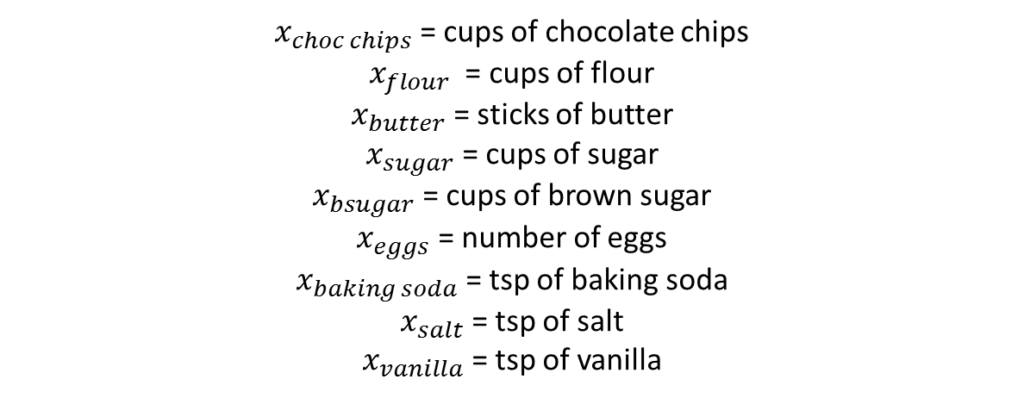
What are the Variables?
The variables of a problem represent a possible solution. These are the unknowns or what we have control over.
Exercise: Write down the variables.
$x_{choc chips}$ = cups of chocolate chips
$x_{flour}$ = cups of flour
$x_{butter}$ = sticks of butter
$x_{sugar}$ = cups of sugar
$x_{bsugar}$ = cups of brown sugar
$x_{eggs}$ = number of eggs
$x_{baking soda}$ = tsp of baking soda
$x_{salt}$ = tsp of salt
$x_{vanilla}$ = tsp of vanilla
Important: clearly state the interpretation of the variables.

Slide 13

What is a Feasible Solution?
$x_{choc chips}$ = 3
$x_{flour}$ = 2
$x_{butter}$ = 0.75
$x_{sugar}$ = 1
$x_{bsugar}$ = 0.5
$x_{eggs}$ = 2
$x_{baking soda}$ = 1
$x_{salt}$ = 0
$x_{vanilla}$ = 0.5
Question: Is this solution feasible (valid)? What do we mean by a feasible solution?
Question: What data do I need in order to write down the feasibility constraints?

Slide 14
What are the Constraints?
The constraints of a problem determine what solutions are feasible.
 | Grams | Calories | Fat (g) | Sat. Fat (g) | Cholesterol (mg) | Sodium (mg) | Carbs (g) | Sugar (g) | Protein (g)
1 Cup Choc Chips | 160 | 840 | 48 | 40 | 0 | 0 | 108 | 96 | 10
1 Cup Flour | 125 | 455 | 0 | 0 | 0 | 0 | 95 | 0 | 13
1 Stick Butter | 113 | 810 | 91.7 | 58 | 242.9 | 12.4 | 0.1 | 0.1 | 1
1 Cup Sugar | 200 | 773 | 0 | 0 | 0 | 0 | 200 | 200 | 0
1 Cup Brown Sugar | 200 | 773 | 0 | 0 | 0 | 0 | 200 | 200 | 0
1 Egg | 53 | 78 | 5 | 1.6 | 186 | 62 | 0.4 | 0.2 | 6.3
1 Tsp Baking Soda | 5 | 0 | 0 | 0 | 0 | 1258.6 | 0 | 0 | 0
1 Tsp Salt | 5 | 0 | 0 | 0 | 0 | 2325 | 0 | 0 | 0
1 Tsp Vanilla | 4.2 | 10 | 0 | 0 | 0 | 0 | 0 | 0 | 0
1 Serving Size | 28 | 140 | 7 | 4.5 | 25 | 150 | 18 | 12 | 2
Exercise: Write down the constraints using the above information and the variables we defined before.

Slide 15
What is the Objective Function?
Question: What is the objective function of the problem?
This is an example of a constraint program or feasibility problem.
Question: What else could we have made the objective function?

Slide 16
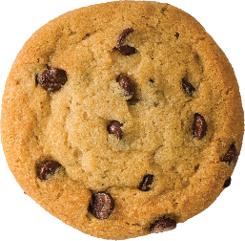
DEM

Slide 17
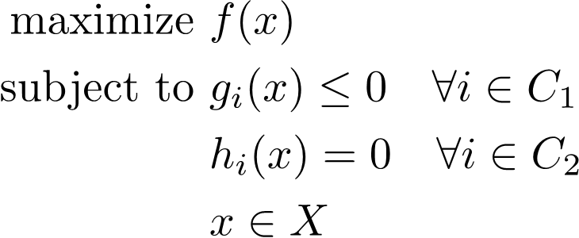
General Optimization Problem
Exercise: Think of other potential applications of optimization problems.
Question: What restriction could we put on the objective function and/or constraints?
Notes:
In this general form the problem is really hard to solve. How could we restrict the constraints or objective function to make the problem easier to solve?

Slide 18
Linear Program
An optimization problem is a linear program if the objective function and constraints are linear functions of the variables.
Question: Was the problem we constructed a linear program?

Slide 19
Linear Program Examples
Hospital Resource Allocation
Gas Network Optimization
Emergency Evacuation
Traffic Management
Notes:
Optimal mix of surgical departments optimizing cost constraints, constrained by beds and operating room time and staff
Minimizing operating costs while meeting constraints, use linear constraints to represent conservation requirements
Analyze worst case time for people to evacuate when some probabilities of failure and capacities of routes
Route communication network traffic

Slide 20
Integer Program
An integer (linear) program is a linear program in which we are allowed to restrict all or some of the variables to be integer.
Question: Suppose we want to restrict $x_{1}$ to be 0 or 1. How can we write this as a mathematical constraint?

Slide 21
Integer Program Examples
Kidney transplants
Transportation routes
Scheduling
Matching problems
Notes:
Variable for whether donor-receipient kidney transplanted, optimize expected life outcomes, limit on length of cycles and transportation
Determining bus routes
Airline crew scheduling
Creating voting districts

Slide 22
Convex Program
A convex program is a math program in which we are minimizing a convex function and the set of feasible solutions is a convex set.
Convex
Not Convex

Slide 23
Convex Program Example
Image restoration
Image segmentation
Signal processing
Linear regression
Notes:
Image restoration: D = A+E (E sparse, A low rank)
Minimize rank(A) + lambda* l1-norm (E)
s.t. D = A+E
Separate background and foreground
Video, image, sound processing
Linear regression

Slide 24
General Nonlinear Program???
Notes:
If we lose convexity, then the problem becomes much harder and our mathematical tools sort of explode.

Slide 25
General Nonlinear Program???
Notes:
Example: traveling salesman problem

Slide 26
Other Considerations
Problem -> model
Be mindful of assumptions and simplifications
Optimization methods
Complexity and available solvers
Notes:
In this class we will let problems motivate the models and we’ll have to consider several things when we create and solve our model

Slide 27
Goal of this Course
Problem
Gather Data
Formulate Model
Solve & Analyze
Notes:
In general, want workflow to become natural so that when you encounter a problem you feel comfortable approaching it. Project at end of class.

